Slide 1
Chapter 10 (part 2)
Dependent t-test

Slide 2
t-test
Dependent t-test
  Compares two means based on related data.
  E.g., Data from the same people measured at different times.
  Data from ‘matched’ samples.

Slide 3
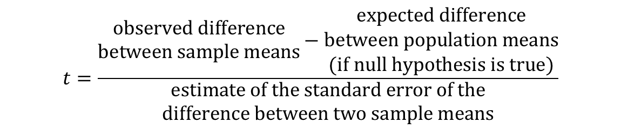
Reminder: Rationale of the t-test
$$t=\frac{\begin{matrix}\text{observed} \text{difference} \\ \text{between} \text{sample} \text{means}\end{matrix}−\begin{matrix}\text{expected} \text{difference} \\ \text{between} \text{population} \text{means} \\ \text{(}\text{if} \text{null} \text{hypothesis} \text{is} \text{true}\text{)}\end{matrix}}{\begin{matrix}\text{estimate} \text{of} \text{the} \text{standard} \text{error} \text{of} \text{the} \\ \text{difference} \text{between} \text{two} \text{sample} \text{means}\end{matrix}}$$

Slide 4
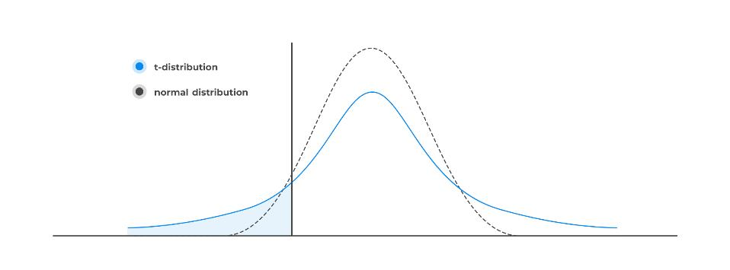
Reminder: t-distribution

Slide 5
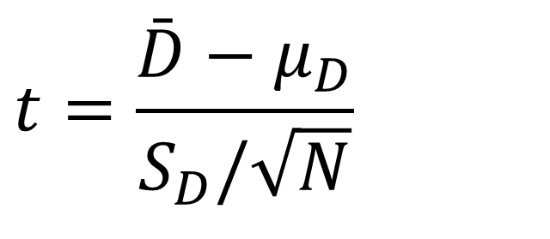
The Dependent t-test
Purpose: Compares the means of two related groups to determine if there is a statistically significant difference between them
When to Use?
The same subjects are measured under two conditions or at two different times.
Common in pre-test/post-test designs or within-subject experiments.
$$t=\frac{\bar{D}−μ_{D}}{S_{D}/\sqrt{N}}$$

Slide 6
Example (1)
A manufacturer wants to test if a new keyboard reduces typing time. Six students typed a term paper on both their regular keyboard (Condition X) and the new keyboard (Condition Y).
Independent variable?
Dependent variable?
Null (H₀): The average difference is zero (μ₍d₎ = 0)—i.e., no effect.
Alternative (H₁): The average difference is not zero (μ₍d₎ ≠ 0).

Slide 7
Example (2)
Student | Regular (X) | New Keyboard (Y) | Difference (d = X−Y)
A | 54 | 52 | 2
B | 63 | 61 | 2
C | 47 | 48 | –1
D | 61 | 58 | 3
E | 52 | 51 | 1
F | 59 | 55 | 4

Slide 8
Example (3)
Condition | N | Mean (min) | Std. Dev. (min) | Std. Error (min)
Regular Keyboard (X) | 6 | 56.00 | 6.40 | 2.61
New Keyboard (Y) | 6 | 54.17 | 4.75 | 1.94
Difference (X−Y) | 6 | 1.83 | 1.72 | 0.70

Slide 9
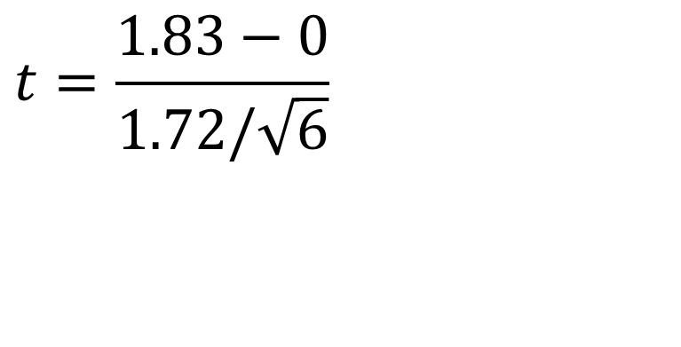
Example (4)
Mean diff
$$t=\frac{1.83−0}{1.72/\sqrt{6}}$$
Population mean diff (why 0?)
S diff
Sample Size
Notes:
The null hypothesis of the paired t‑test assumes no true difference between the two conditions.

Slide 10
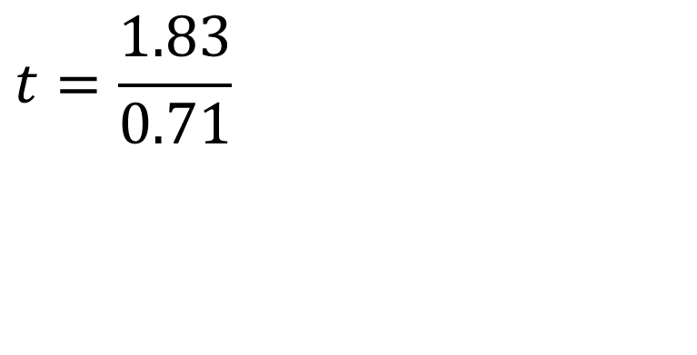
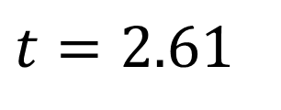
Example (5)
$$t=\frac{1.83}{0.71}$$
$$t=2.61$$
Is this difference significant? What is the critical t? What is the p-value?
Notes:
The null hypothesis of the paired t‑test assumes no true difference between the two conditions.

Slide 11
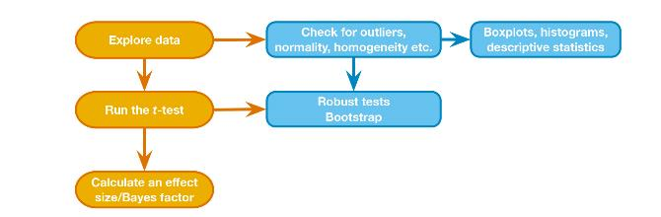
Reminder: t-test General Process

Slide 12
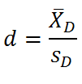
Effect Sizes (1)
Common effect size for t-tests: Cohen’s d
  Measures the standardized difference between two means.
Dependent Samples

Slide 13
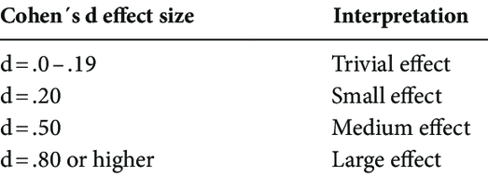
Effect Sizes (2)

